Slide 1
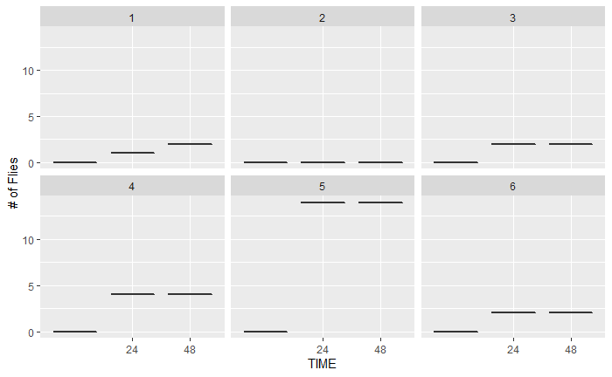
USDA STARVED FLIES

Slide 2
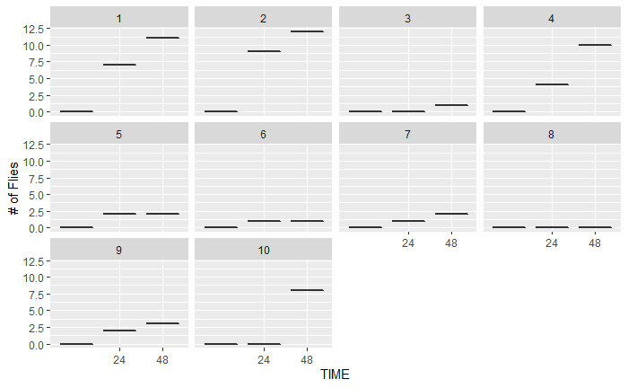
USDA FED FLIES

Slide 3
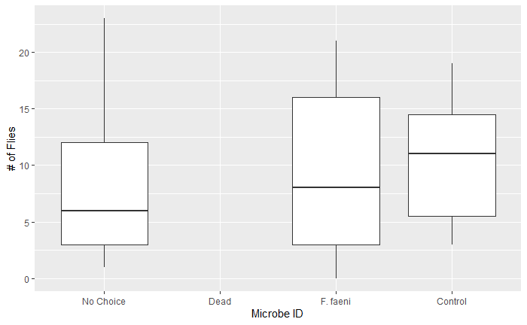
UF REPELLENT VS. CONTROL

Slide 4
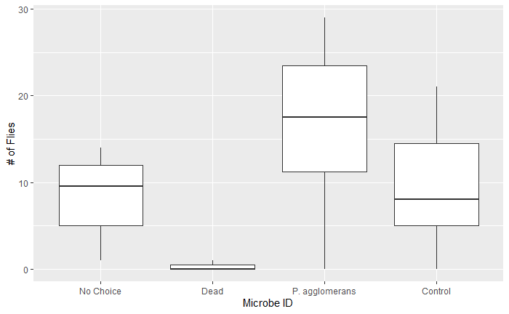
UF ATTRACTANT VS. CONTROL

Slide 5
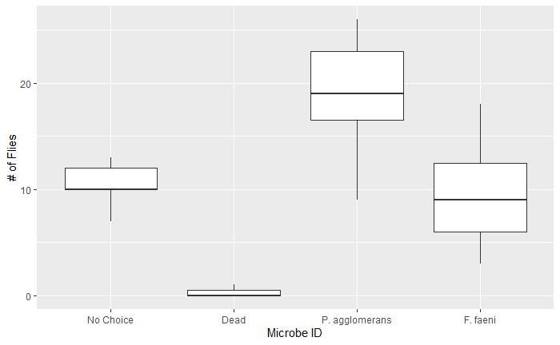
UF ATTRACTANT VS. REPELLENT

Slide 6
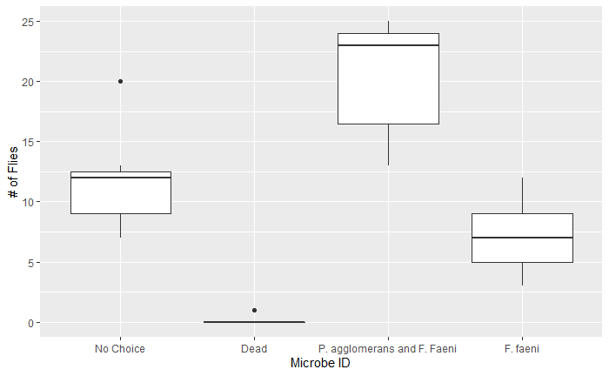
UF MIX VS. REPELLENT

Slide 7
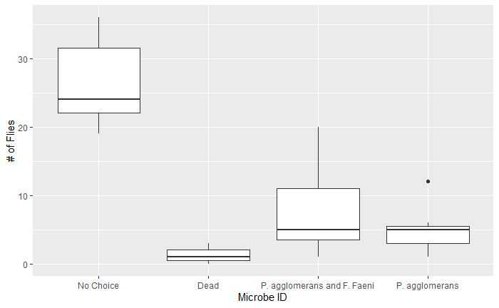
UF MIX VS. ATTRACTANT

